Slide 1
Ordinary Differential Equations
PHYS3112 – Tutorial 4

Slide 2


Writing your ODEint-able function
Your function / derivative COULD depend on time (t), or it could depend on the current status of the system (y).
Any ODE int function needs to take in a current state (y – which can be an array of states if you’ve got multiple variables), and a time base (t), even if only one is needed to evaluate the derivative.

Slide 3
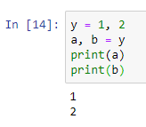
Syntax Break! – A tuple
In ODEint implementations you’ll often see something of the form;
a, b = y.
This is not giving a and b the same value. In fact, y is a ‘tuple’, which is a variable consisting of comma separated values (eg, y = 1,2).
In this case, a is assigned the first value in the tuple, and b the second.

Slide 4
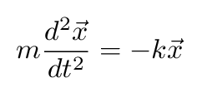

Normal Form Functions
ODE int can only handle first derivatives. If you have something with a second derivative, you need to make it into first-derivative only form. We normally do this by introducing intermediate variables.
For example, the simple harmonic oscillator;
We would define v = dx/dt and express this equation as two equations using both x and v:

Slide 5

The Assignment!
1 . Turn the Coupled Pendula equations into a series of 1st order ODEs
2. Simulate them for various conditions (l, k etc).
3. Analyse the results using Fourier methods and compare to your experiment!

Slide 6
GO AND LOOK AT MICHAEL’S NOTEBOOK (THEY ARE VERY GOOD)
Mcba2-numerical integration of ODEs
https://github.com/phys3112/intro/blob/master/mcba2-numerical-integration-of-ODEs.ipynb

